Slide 1
Flowcharts
A supplemental lesson for Lift-Off with CodeX

Slide 2
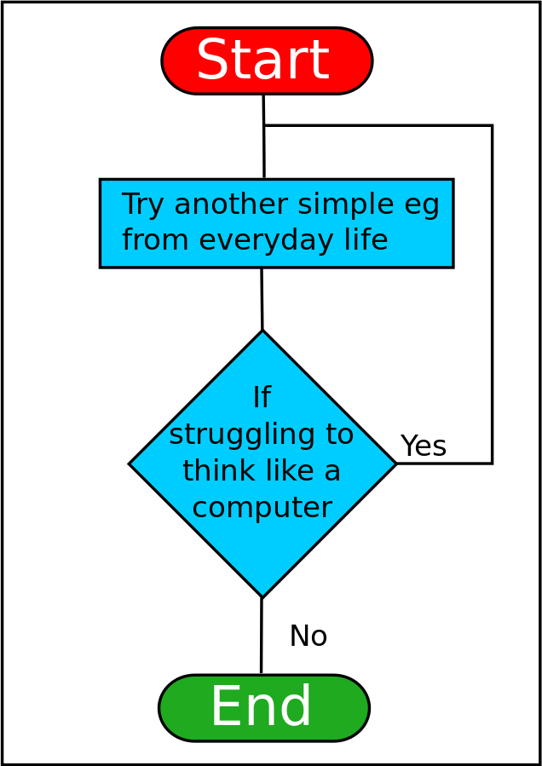
Flowcharts
A useful tool programmers (and many other professionals!) use is a flowchart. Flowcharts can help you:
Organize your thoughts and ideas
Use shapes to visualize the solution
Track variables
Identify computations
Look for patterns
Source: https://en.wikiversity.org/wiki/File:ThinkLikeComputerFlowchart.svg

Slide 3
Flowcharts

Slide 4
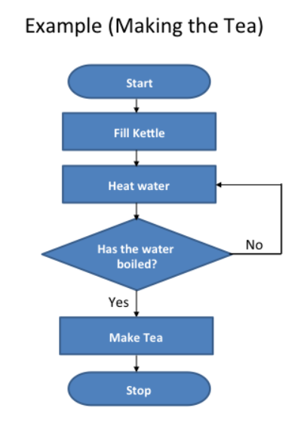
Flowcharts
A flowchart visualizes the algorithm, or how to solve the problem.
There are four common shapes used when creating a flowchart:
Source: https://www.teachwithict.com/flowcharts.html#google_vignette

Slide 5
Flowchart symbols
Use an oval to mark the beginning and end of the program.
start or stop
Use a parallelogram to show input or output. Input could be the button pressed. Output could be text on the screen, an image displayed, a pixel lit or a sound played.
input or output
flow lines
Use a rectangle to process an action. It could be used to assign a value to a variable, or increment a counter, or get a random number.
action or process
Use lines to connect the shapes. The arrows show the direction of the steps. Some lines should include labels, such as yes or no, to explain what is happening.
Use a diamond to make decisions. This shape will have two or more lines that come from it – one for each outcome. This step might ask a question or provide options. The result could be true or false, yes or no, or choices (red, blue, or green).
decision

Slide 6
Flowcharts
This example doesn’t include any input or output.
What can you think of to add to this flowchart?
What are some other examples of how the shapes might be used?
Source: https://www.teachwithict.com/flowcharts.html#google_vignette

Slide 7
Flowchart example
Display the answer
These shapes are mixed up. It doesn’t follow the algorithm for summing numbers.
Can you fix the algorithm by putting the events in the correct order?
Sum the numbers
Start
Stop
Player enters two numbers
Give instructions

Slide 8
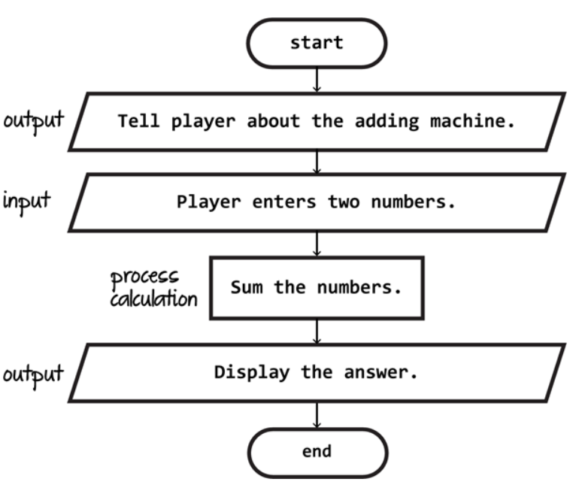
Did you get something like this?
Source: https://blog.technokids.com/programming/how-to-make-a-flowchart-for-programming-easy-to-understand/

Slide 9
Flowchart example
Computer gets a random number
Some of the steps are in the wrong shape, and they are out of order. Can you fix this flowchart for guessing a number?
Give instructions
Display “you guessed it!”
Player enters a number
Did the player guess the number?
start
stop
Display “You didn’t guess it”

Slide 10
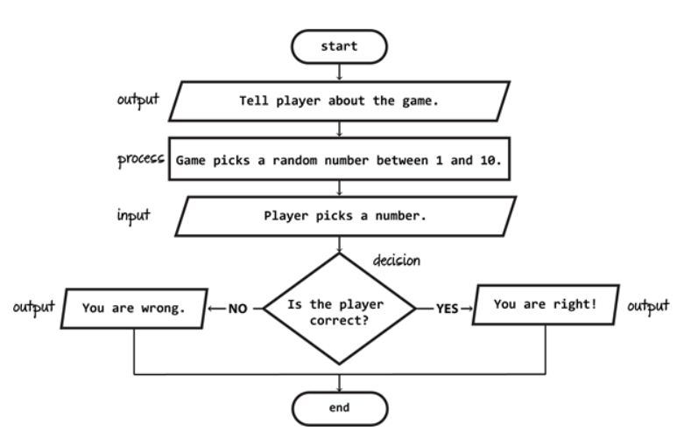
Did you get something like this?
It doesn’t have to be exactly the same – there can be more than one solution to a problem!
Source: https://blog.technokids.com/programming/how-to-make-a-flowchart-for-programming-easy-to-understand/

Slide 11
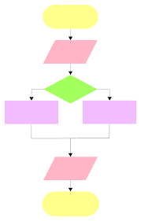
Try one:
With your partner, select a scenario and create a flowchart:
Get ready for school
Select a song to listen to
Decide what to wear today
What should I eat for breakfast?
Do I eat lunch today?

Slide 12
Flowcharts
You are now familiar with flowcharts, their shapes, and what each shape is used for.
Let’s look at examples in Python programming.
Source: https://www.teachwithict.com/flowcharts.html#google_vignette

Slide 13
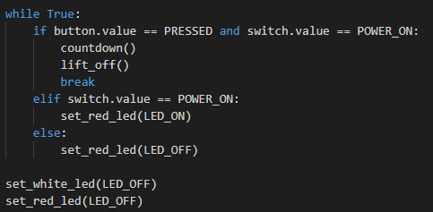
Example #1
Here is the main program from Mission 2 Lift-Off.
What could a flowchart of this code look like?
Try it on your own. Then look at a sample solution on the next slide.

Slide 14
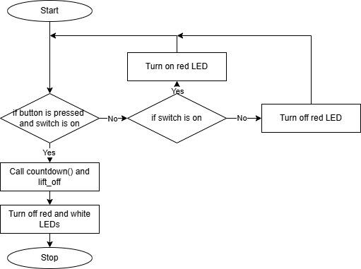
Example #1

Slide 15
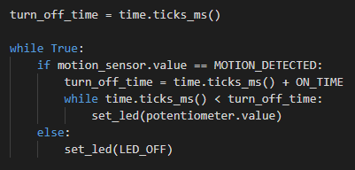
Example #2
Here is the main program from Mission 3 Conserve Energy.
What could a flowchart of this code look like?
Try it on your own. Then look at a sample solution on the next slide.

Slide 16
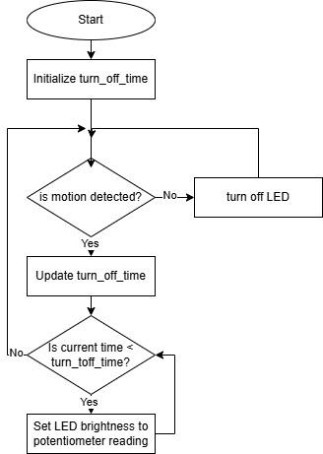
Example #2

Slide 17
Flowcharts Summary
Definition: An algorithm is a sequence of steps for completing a task.
Definition: A flowchart is a diagram that uses shapes, lines, and arrows to sequence steps.
Definition: A flowchart is a visual representation of the input, output, decisions, and actions that take place within a program.
Source: https://www.teachwithict.com/flowcharts.html#google_vignette

